Slide 1


Govt. Sri Krishnarajendra Silver Jubilee Technological Institute
Department of Computer Science and Engineering
Internship Seminar
Presentation on:
“House Price Prediction using Machine Learning”
Presented by :
Mallikarjun Gokak - 1SK17EC022
Under the guidance of :
Shaik MD Rasool Director AIROBOTICA SERVICES PVT. LTD Bangalore
Internship Coordinator :
Prof. Mamatha.R
Dept of CSE

Slide 2
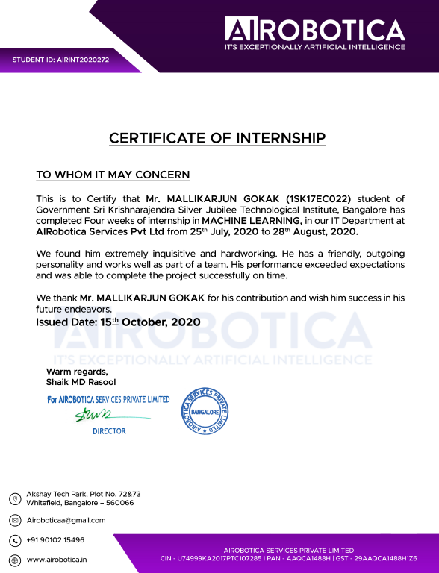
INTERNSHIP CERTIFICATE

Slide 3
CONTENT
Company Profile
Task performed
Domain
Libraries
Algorithms
Project
flowchart
Snapshot
Conclusion
References

Slide 4

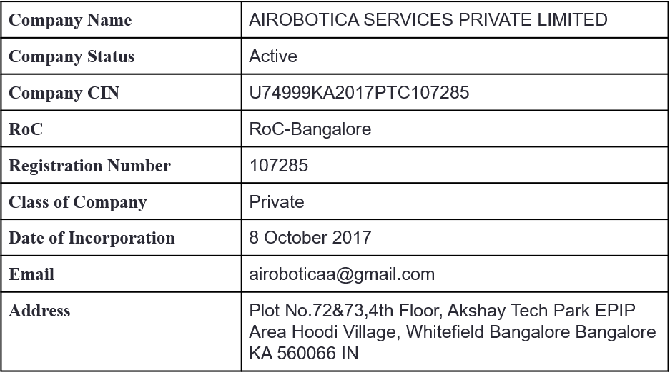
COMPANY PROFILE

Slide 5
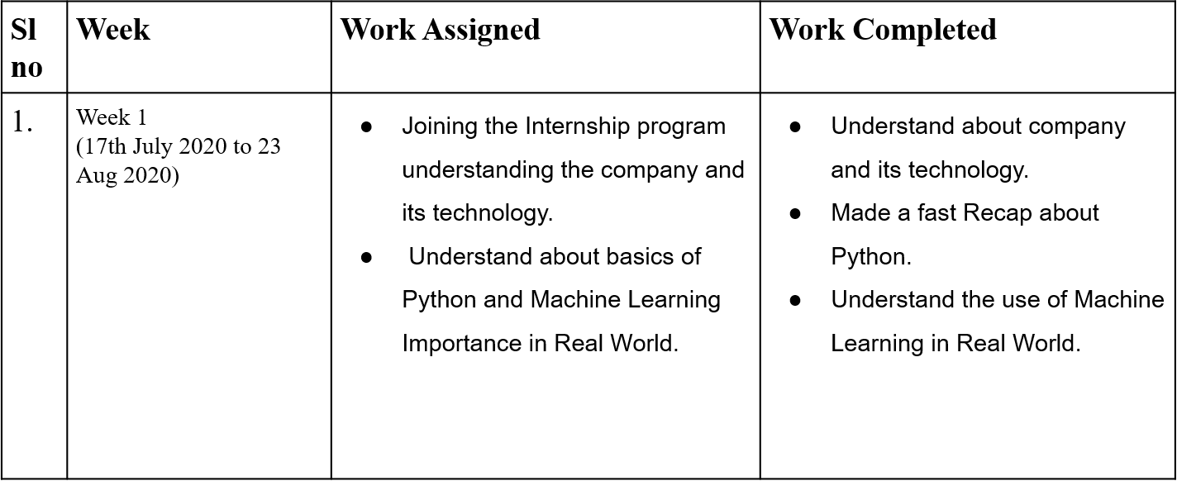
TASK PERFORMED

Slide 6
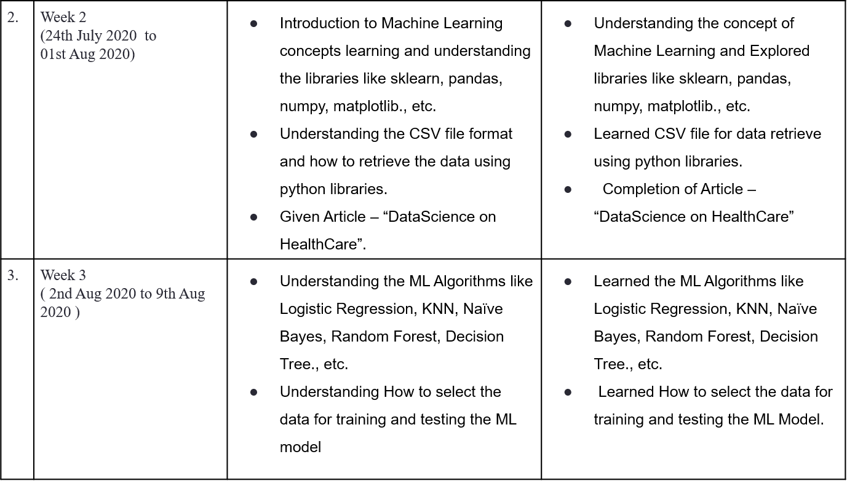

Slide 7
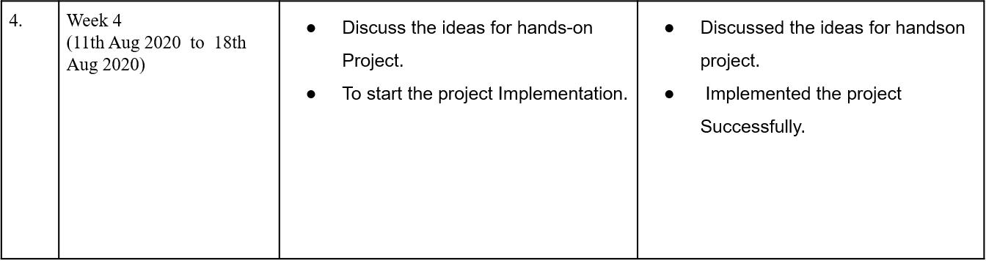

Slide 8
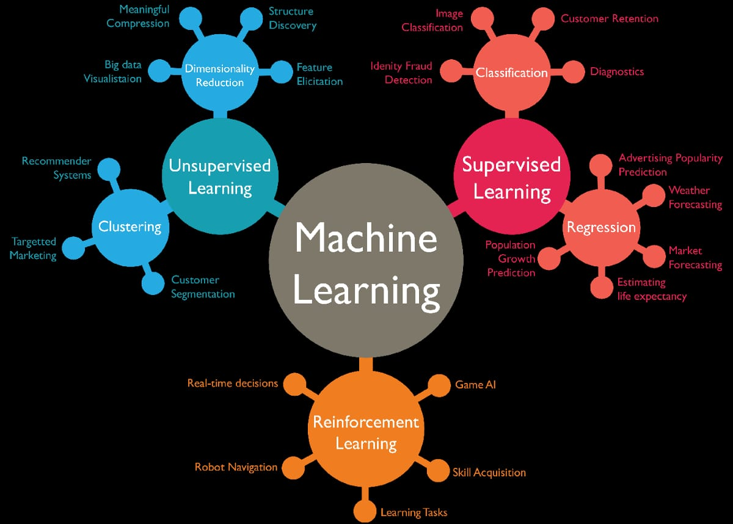
DOMAIN
Machine Learning:
Machine Learning is a subfield of Artificial Intelligence, which enables machines to learn from past data or experiences without being explicitly programmed.
TYPES OF ML

Slide 9
LIBRARIES
ALGORITHMS
NumPy
Pandas
Sklearn
TensorFlow
Matflotlib
Linear regression
Logistic regression
Support vector machines (SVM)
Decision tree

Slide 10
PROJECT
House price Prediction using Machine Learning:
This Machine Learning Project which is trained the model using the Linear Regression using the data which have different locations in Bangalore.
Linear regression, y=mx+b.
This model takes the Area (Square Feet), BHK, Bathrooms and Locations, as a parameters to predict the estimated price.
CSV file contain the following fields :
area_type
availability
location
size
society
total_sqft
Bath
Balcony
price

Slide 11
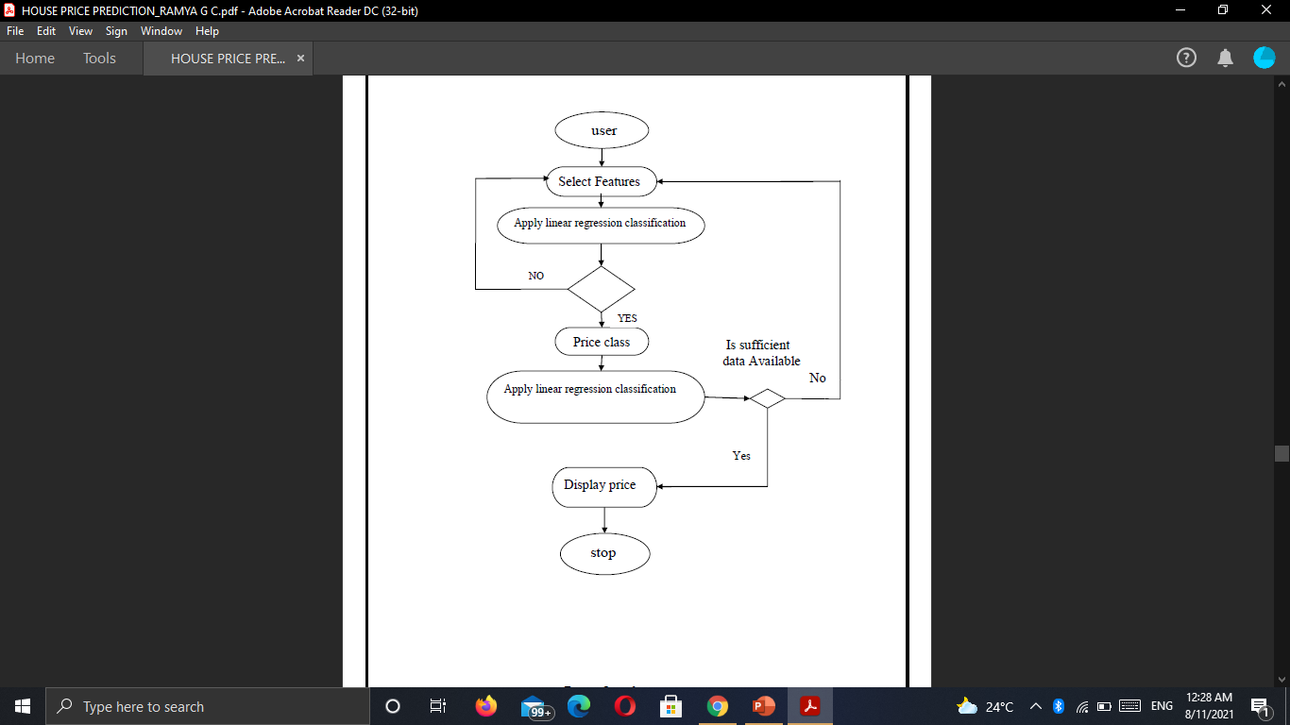
FLOW CHART
Fig: flow chart

Slide 12
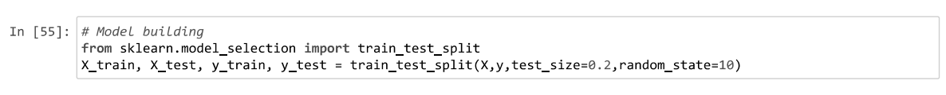
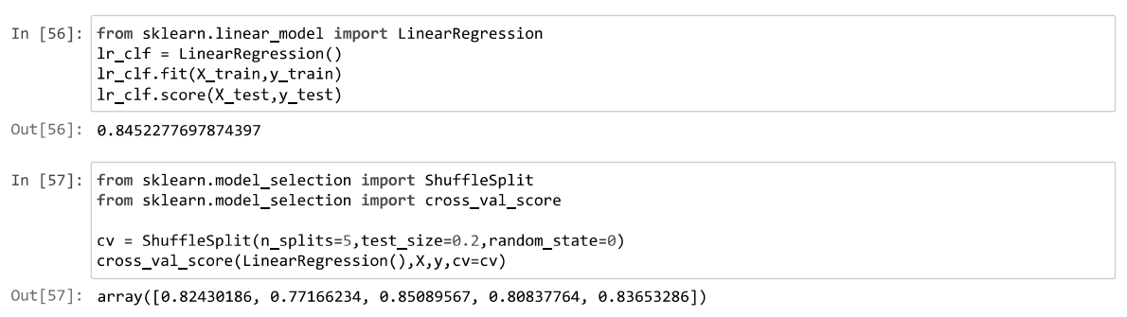
SNAPSHOTS
Model Training:
Fig 1 Model Training

Slide 13
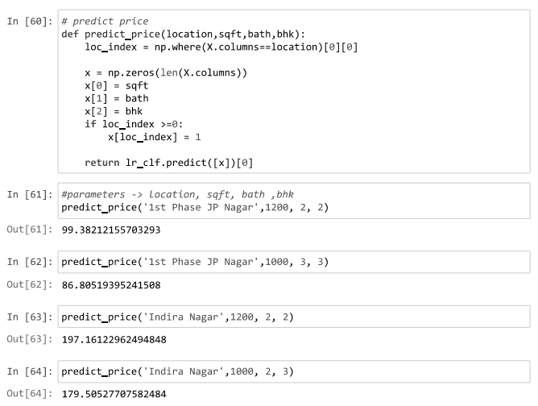
Model Testing:
Fig 2 Model Testing

Slide 14
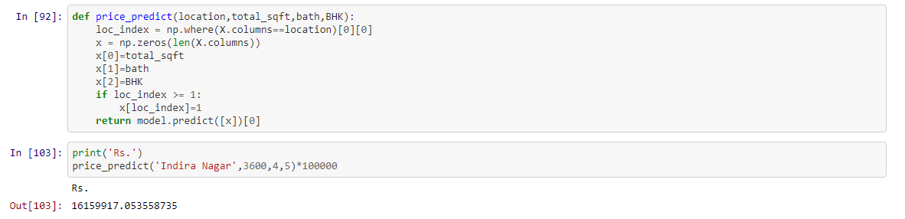
RESULTS AND ANALYSIS
After training with the linear regression algorithm, we have validate our trained algorithms with test data set and measure the algorithms performance with goodness of fit with the dataset.
80% of data as training data set and 20% as testing data set. The accuracy of predicting the house price using Linear regression algorithm is 92%.
Fig 3 Estimated price for house at Indira nagar

Slide 15
CONCLUSION
Machine Learning is evolving into a self-supporting discipline and producing professionals with distinct and complementary skills relative to professionals in computer information.
In this House price prediction user can enter the parameters like location, BHK size, Bath and Area (Sqft) for his own interested area to buy the house in that location.

Slide 16
REFERENCES
Python: https://www.python.org/
Tutorialspoint: https://www.tutorialspoint.com/machine_learning_with_python/
Javatpoint: https://www.javatpoint.com/machine-learning
Kaggle: https://www.kaggle.com/learn/intro-to-machine-learning
Medium: https://medium.com/
Dev: https://dev.to/
Stackoverflow: https://stackoverflow.com/

Slide 17
THANK
YOU

